Slide 1
Notes:
Unmet need= Decades of miseducation of African-American Youth from achieving free thinking, their geniuses, their freedom of mind to change their communities. Can you help me with this narrative?
We have 27 years of service to the youth, their families and the community. 27 years of Goodwill.

Slide 2
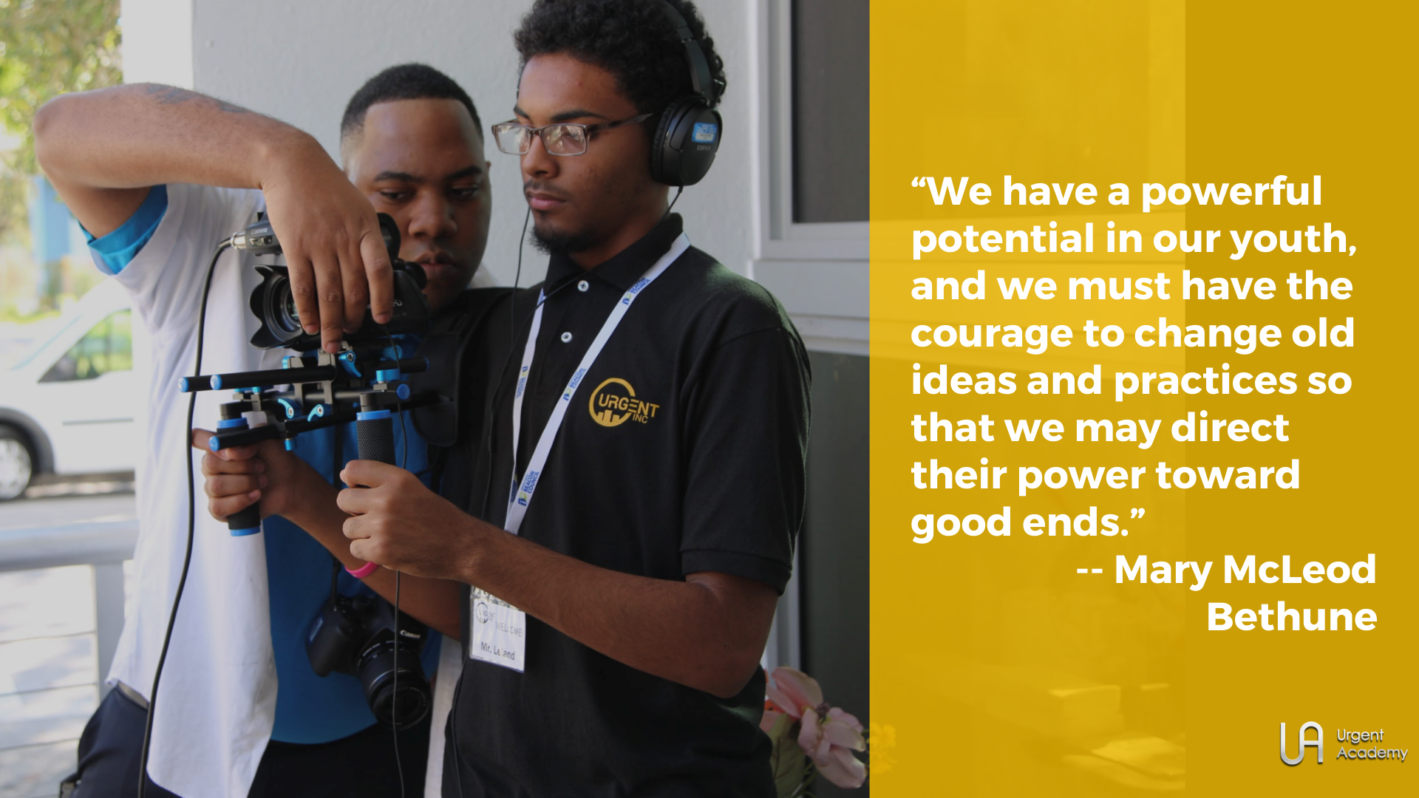
CONGRATULATIONS

Slide 9
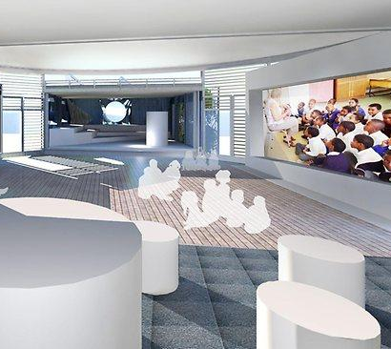
Multi-Purpose Presentation Wall Spaces
...

Slide 10
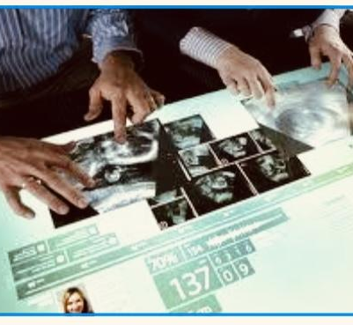
Multi-Tasking Student Computers
...

Slide 11
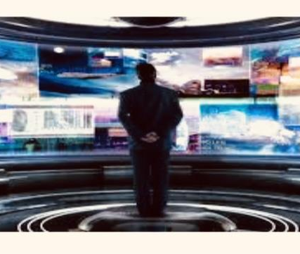
TV Broadcast Studio
...

Slide 12
Board
Recruitment

Slide 14
How You Can Help?
Become part of our Dev. Leadership.
Become Honorary Member
Join Honorary Member Committees
Texting SUPPORTURGENT to
(833)565-0777 to Donate
Donate to your Social Media Campaign
Lights on Afterschool, Give Miami Day
Committees available: Suggestions
please.

Slide 15
Naming Rights
Sponsorships

Slide 16
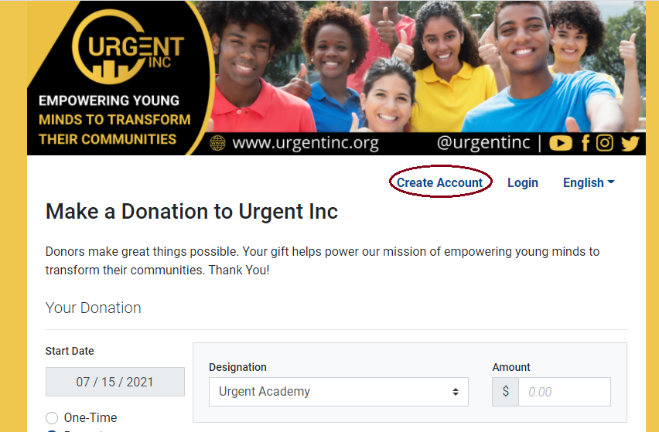

Slide 17
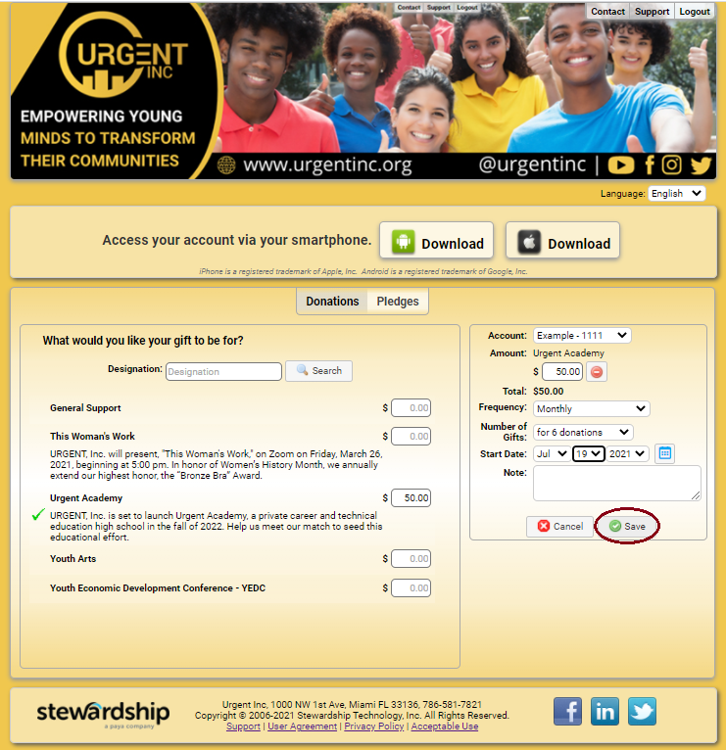
..
..

Slide 18
CONGRATULATIONS, SALIHA NELSON, EdD

